Slide 1
Radiograms and Traffic Handling

Slide 2
Parts of the Radiogram
Preamble
Filling out the top line of the Radiogram
Address
How to address the message and what to look for
The Message
How to write down the message
Precautions and use of abbreviations
Counting the words
Sending and Receiving messages
What to fill out when sending a message
What to fill out when receiving a message
LEE COUNTY, FLORIDA A.L.E.R.T.
2
Notes:
2

Slide 3
Preamble
Message Number and Precedence
Message Number
Assigned by the person first filling out the Radiogram this number stays with the message until delivery.
Number your messages consecutively starting at the beginning of the month or year.
Precedence (E, P, W, or R)
E = Emergency (Life or Death urgency in a declared Emergency)
P = Priority (Official traffic in a declared Emergency)
W = Health & Welfare (Used only in a declared Emergency to report persons wellbeing)
R = Routine (this is the most used precedence covering everything else)
LEE COUNTY, FLORIDA A.L.E.R.T.
3

Slide 4
Preamble
Handling Codes (Optional)
HX –Handling Code (Optional)
(Followed by number) Collect landline delivery authorized by addressee within...miles. (If no number, authorization is unlimited.)
(Followed by number) Cancel message if not delivered within...hours of filing time; service originating station.
Report date and time of delivery (TOD) to originating station.
Report to originating station the identity of station from which received, plus date and time. Report identity of station to which relayed, plus date and time–or, if delivered–report date, time and method of delivery.
Delivering station get reply from addressee, originate message back.
(Followed by number.) Hold delivery until...(date).
Delivery by mail or landline toll call not required. If toll or other expense involved, cancel message and service originating station.
LEE COUNTY, FLORIDA A.L.E.R.T.
4

Slide 5
Preamble
Station of Origin and Place of Origin
Station of Origin
This is the person who is filling out the Radiogram form!
If someone else sends the message–by whatever means–the originator is still the person who filled out the paper form.
The answer, if there is one, should be returned to the person who originally took the message or the “Station of Origin”.
Place of Origin
This is the City and State where the person taking the message was when the message was originated.
If you live in Reno, Ohio but you are in Fort Madison, Iowa when you take a message for someone to be delivered to Nashville, Tennessee, then your message originates in Fort Madison, Iowa.
LEE COUNTY, FLORIDA A.L.E.R.T.
5

Slide 6
Preamble
The Date, Check and Time Filed Fields
Date
This is the Date on which the message form was filled out. Use Alpha characters for month and two digits for the day. Don’t include the year.
Check
This is the word count for the body of the message. Don’t count words in the Preamble, Address or Signature. (Do this after the message area has been filled in)
Time Filed
This is the local time at Place of Origin. Don’t forget to indicate your time base (Z, EDT, ET, CDT, etc.) (Do this last – After everything else is filled out)
LEE COUNTY, FLORIDA A.L.E.R.T.
6

Slide 7
Address
The Address of the Recipient
To
Enter the complete mailing address for the recipient. If the recipient is a ‘Ham’ then include the Call Sign. Leave out the punctuation.
Telephone Number
(This is important – Get it) The telephone number is part of the delivery address. Make sure you get the phone number of the recipient. Most messages are delivered by Telephone.
This Radio Message was Received At
If you are receiving this message for delivery, then fill out this block. There is an additional Received block at the bottom of the Message Form for the “From, Date and Time Information.” (see slide 10)
LEE COUNTY, FLORIDA A.L.E.R.T.
7

Slide 8
The Message
The Message text and Signature
The Message Body
Each space contains one word, five to a line. The X indicates a period and the message can be ended with the word ‘END’ or ‘AR’. This message has a ‘CHECK’ or word count of 17.
Signature
There is no space for your signature. Just include it along with your call sign at the bottom of the message.
LEE COUNTY, FLORIDA A.L.E.R.T.
8

Slide 9
Word Counting
A word about counting words
How the count goes
The box labeled ‘Check’ is the number of words in the text of the message only. When counting words, numbers count as one word. Punctuation is not used. End each sentence with an X or Xray. (Stands for period).
Some examples
Example | Count
Fort Myers Florida | 3 words
527B | 1 word
FM | 1 word
Fifty Six | 2 words
H O Townsend | 3 words
KK4ABC | 1 word
LEE COUNTY, FLORIDA A.L.E.R.T.
9

Slide 10
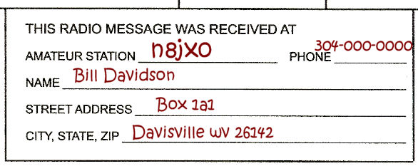
Send and Receive
The Received and Sent Blocks
The Sent block
If you are the person sending the message fill out this block. The ‘To’ block is the person/phone number/PBBS/etc. where you left the message. The ‘Date’ is recorded as MMMDD and the ‘Time’ is recorded as 0000 EDT
The REC’D block
If you are using the Radiogram form to receive a message then you fill out this box. This block is the person/phone number/PBBS/etc. who is sending you the message. The ‘Date’ is recorded as MMMDD and the ‘Time’ is recorded as 0000 EDT. Don’t forget the box in the upper right above the message block.
Wood County Emergency Communications WC8EC
10

Slide 11
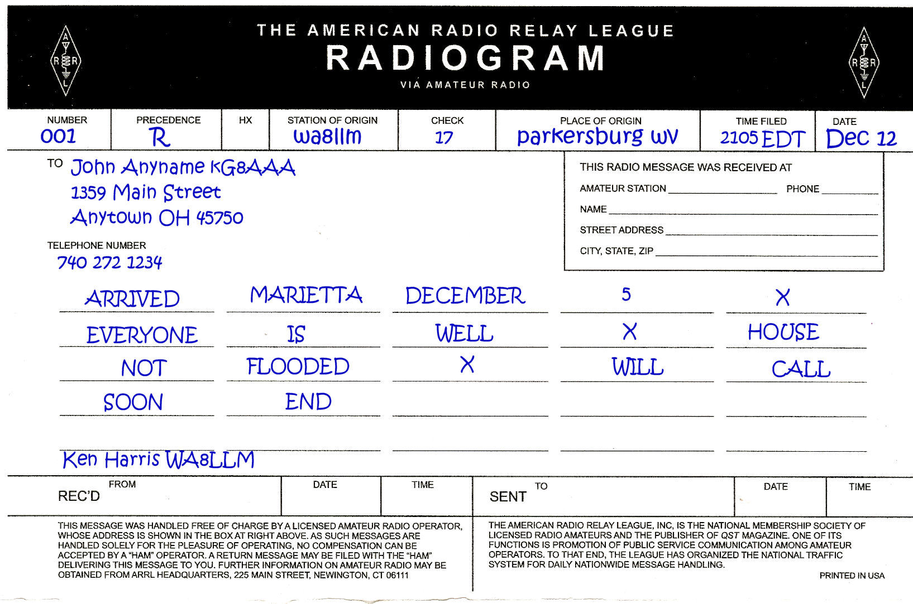
The Completed Radiogram
The Completed Form Ready to Send
Wood County Emergency Communications WC8EC
11

Slide 12
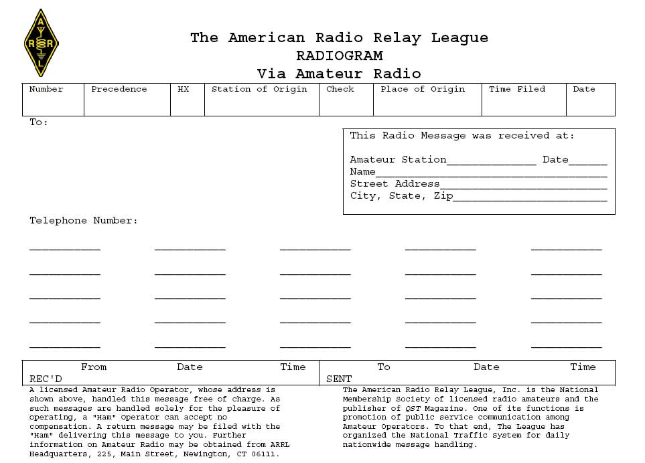
Numbered Radiograms
27
R
C
W1GMF
ARL13
ABINGTON, MA
15:30Z
8 Jan
Henry Ham / K5HAM
123 Elm Street
Anytown, TX 75000
(999)123-4567
ARL
FIFTY
ARL
FIFTY
SIX
NEW
CALLSIGN
ARL
SIXTY
NINE
AMATEUR
RADIO
WORLD
condensed way of sending text
include “ARL” in check
in text, include “ARL” and the radiogram number, spelled out
example: “ARL Forty Six,” which counts as 3 words

Slide 13
Sending a Message (Phone)
don’t say labels such as “priority” and “station of origin”
read at about half of normal reading speed
say “Break” and unkey immediately before and after the text
if the text is long, unkey during the text to allow recipient to ask for fills
Notes:
read at rate that you could copy

Slide 14
Sending a Message (Phone)
Use prowords:
“I spell”
“figures”
“initial”
“direction”
“operator’s note” (usually after the message)

Slide 15
Sending a Message (Phone)
Other prowords:
“over”
“out”
“clear”
“roger”
“affirmative”
“negative”
“say again”

Slide 16
Sending a Message (Phone)
when spelling, use ITU phonetics
say “niner” for the number nine
at the end of the message:
say “End, no more”, or “End, one more”, etc.
say your call sign
Notes:
non-standard phonetics are confusing - example, “kilowatt” - I automatically think “KW”
by saying your call sign at end, you don’t have to sign later - more efficient

Slide 17
Receiving a Message (Phone)
to ask for “fills”, say:
“please say again, word after …”
“please say again, word before …”
“please say again, all between …”
“please confirm …”
compare the check to the number of words you copied
once you have copied the message successfully, say “I roger your number …”
Notes:
sender would reply: “i say again …”
ask while you have the chance - get it right!
btw, “roger” means “i successfully copy” - it does not mean “i agree”

Slide 18
Note on Message Text
NEVER “correct” the text of a message.
If, for some reason, you feel the text was received incorrectly, ask for a fill.
If the fill is the same as the original copy, but you still feel it is incorrect, NEVER “correct” the text yourself. Use the text as sent to you.
It is OK to query back to the originator.
Notes:
sender would reply: “i say again …”
ask while you have the chance - get it right!
btw, “roger” means “i successfully copy” - it does not mean “i agree”

Slide 19
Delivering a Message
by telephone, e-mail, US mail
if delivering by phone, identify yourself and say that you have a “greeting message” or “friendly message”
don’t say “X-ray” or “Query”
expand ARL radiograms
if you can’t deliver the message, service it back

Slide 20
Servicing Back
unable to forward or deliver in 48 hours
handling instructions request service back
HXB
HXC
HXD
HXE
HXG
Use ARL 67 with at least 2 fills

Slide 21
ARRL National Traffic System (NTS)
Transcontinental Corps (TCC)
Area Nets
Region Nets
Section Nets
Local Nets

Slide 22
SWFTN
SouthWest Florida Traffic Net
Local affiliate of the NTS
Is a directed net
Net control first calls for stations with traffic only, then stations with or without traffic
Net Control directs stations receiving the traffic to call the station sending it
Notes:
ask: what is a directed net?

Slide 23
SWFTN
when checking in
Say “Net Control” then unkey
give your call sign phonetically
wait to be acknowledged by Net Control
list your traffic (or say “no traffic”)
say if you can handle any of the traffic listed
remain on-frequency unless excused by net control

